Slide 1


Jato Daniel
29th March, 2023

Slide 2
Outline
Executive Summary
Introduction
Methodology
Results
Conclusion
Appendix

Slide 3

Executive Summary
Summary of methodologies
Data collection through API and Web Scraping
Data wrangling
Exploratory Data Analysis with SQL
Exploratory Data Analysis with Pandas & Maplotlib
Interactive Visual Analytics with Folium
Interactive Dashboard with Plotly Dash
Predictive Analysis (Classification)
Summary of all results
Data Wrangling results
Exploratory data analysis results
Interactive Dashboard results
Predictive analysis (Classification) results

Slide 4

Introduction
Project background and context
Companies are making space travel affordable for everyone. Virgin Galactic is providing suborbital spaceflights. Blue Origin manufactures sub-orbital and orbital reusable rockets. Spaces X’s Falcon 9 launch like regular rockets. Perhaps the most successful is SpaceX. One reason SpaceX can do this is the rocket launches are relatively inexpensive. SpaceX advertises Falcon 9 rocket launches on its website with a cost of 62 million dollars. other providers cost upwards of 165 million dollars each, much of the savings is because SpaceX can reuse the first stage. Therefore, the aim of this project is to determine if the first stage will land with the aid of machine learning.
Problems you want to find answers
To determine if the first stage will land will land Successfully
To determine the price of each launch.
To determine the most important features that will determine a successful landing.

Slide 5

Section 1

Slide 6

Methodology
Executive Summary
Data collection methodology:
Data was collected from the SpaceX REST API and web scraping from wikipedia
Perform data wrangling
Data was wrangled to determine success rate
Perform exploratory data analysis (EDA) using visualization and SQL
Various graphs such as scatter charts and bar charts were created to trends and relationships between features.
Perform interactive visual analytics using Folium and Plotly Dash
Perform predictive analysis using classification models
How to build, tune, evaluate classification models

Slide 7

Data Collection
The data was collected from web and SpaceX REST API
Get request was performed using the requests library to obtain the launch data.
The response data was in the form of json object which was converted to a dataframe and normalized.
Data was also obtained from Wikipedia using webscraping
Columns and variable names were extracted from the HTML table header.
These data were presented in dataframes
The data was cleaned and presented in the desired format

Slide 8

Data Collection – SpaceX API
Request and parse the SpaceX launch data using the GET request.
Decode the response content as a Json using .json() and turn it into a Pandas dataframe using .json_normalize()
The data from these requests are stored in lists and wused to create a new dataframe.
The dataset is filtered to include Falcon 9 launched
The dataset is wrangled to deal with missing numbers and the then save to the desired format
https://github.com/Dedonrukks/Data-Science-Capstone-Project/blob/main/Data%20Collection%20API.ipynb

Slide 9

Data Collection - Scraping
Request the HTML page from wiki page URL
Create a BeautifulSoup object from the HTML response
Extract all columns/variable names from the HTML table header
Create a dataframe by parsing the launch HTML table
Save the dataset in the desired format (CSV)
Place your flowchart of web scraping here
https://github.com/Dedonrukks/Data-Science-Capstone-Project/blob/main/Webscraping.ipynb

Slide 10

Data Wrangling
Import the libraries and load the SpaceX dataset
Data Wrangle to calculate the number of launches on each site
Data wrangle to calculate the number and occurrence of each orbit
Data wrangle to calculate the number and occurrence of mission output per orbit type
Create a landing outcome label from outcome column
https://github.com/Dedonrukks/Data-Science-Capstone-Project/blob/main/Wrangling.ipynb

Slide 11

EDA with Data Visualization
Visual Exploratory data analysis was performed to better understand the trends of the features and to establish the existing relationships in the dataset
Catplot was used in order to visualize the relationship between flight number and launch site. We discovered that no rocket launched for heavy payload mass greater than 10000
Bar chart was used to visualize the relationship between success rate of each orbit
Scatter plots were used to visualize the relationship between flight number and orbit type, payload and orbit type.
Line plot was used to visualize the success yearly trend
https://github.com/Dedonrukks/Data-Science-Capstone-Project/blob/main/EDA%20Data%20Visualization.ipynb

Slide 12

EDA with SQL
Summary of the SQL queries performed
Names of the unique launch site in the space mission
5 launch sites that begin with the string CCA
Total payload mass carried by boosters launched by NASA (CRS)
Display the average payload mass carried by booster version F9 v1.1
Date when the first successful landing outcome in ground pad was achieved.
Names of boosters which have success in drone ship and have mass greater than 4000 but less than 6000
Total number of successful and failure mission outcomes
Rank of successful landing outcomes.
Records of month, failure landing outcomes, booster version and launch site for the year 2015
https://github.com/Dedonrukks/Data-Science-Capstone-Project/blob/main/SQL%20EDA.ipynb

Slide 13

Build an Interactive Map with Folium
Folium Markers were used to mark all launch site on a map.
Folium markers were used to mark the success/filed launches for each site on the map. Here we used a green marker for a successful launch and a red marker for a failed launch
Folium markers were used to calculate the distances between a launch site to its proximities. Distances between coastlines and launch site were calculated.
Folium circles to add a highlighted circle area with a text label on a specific coordinate and also used for each launch site on the map.
Polylines between a launch site to the coastline point were drawn
Proximities of launch sites to important landmarks like railways, highways, coastlines and cities were shown.
https://github.com/Dedonrukks/Data-Science-Capstone-Project/blob/main/Launch%20Site%20Location%20with%20Folium.ipynb

Slide 14

Build a Dashboard with Plotly Dash
The plotly dashboard was used to find more insights from the SpaceX dataset.
Pie Chart was used to used to show the total successful launch by sites. This showed sites with largest successful launches and successful ratings.
Scatter chart was also used to show the correlations between payload and success for all sites. This show payload range with highest and lowest success rate. Pie charts and scatter charts were used to visualize the launch records of SpaceX.
Success rate of the various F9 booster version was also shown
https://github.com/Dedonrukks/Data-Science-Capstone-Project/blob/main/Plotly%20dash_interactivity.py

Slide 15

Predictive Analysis (Classification)
We built a machine learning a machine learning pipeline to predict if the first stage of the falcon 9 will land successfully.
This begins with preprocessing of the dataset. This was followed by standardizing the dataset.
Splitting the dataset into training and testing dataset
Models such as Logistic regression, Support Vector Machines, Decision tree and K Nearest neighbours were used to train and test the data
GridSearch was performed allowing us to find the best hyper parameters that allow a given model to perform best
https://github.com/Dedonrukks/Data-Science-Capstone-Project/blob/main/SpaceX%20Machine%20Learning%20Prediction.ipynb

Slide 16

Results
Exploratory data analysis results
Interactive analytics demo in screenshots
Predictive analysis results

Slide 17

Section 2

Slide 18
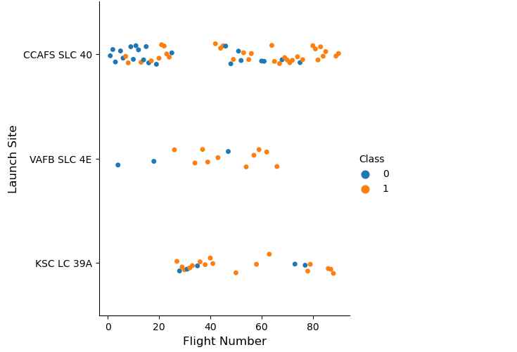
Flight Number vs. Launch Site
CCAFS SLC 40 appears to have the highest number of flight numbers and the highest number of success rate. Therefore, it seems the more the flight numbers, the greater the success rate.

Slide 19
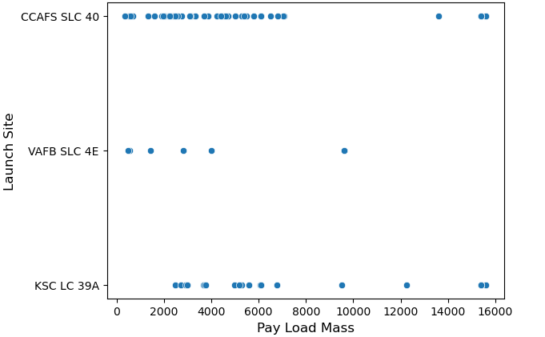
Payload vs. Launch Site
For the VAFB SLC 4E launch site, there are no rockets launch for heavy payload mass greater than 10000

Slide 20
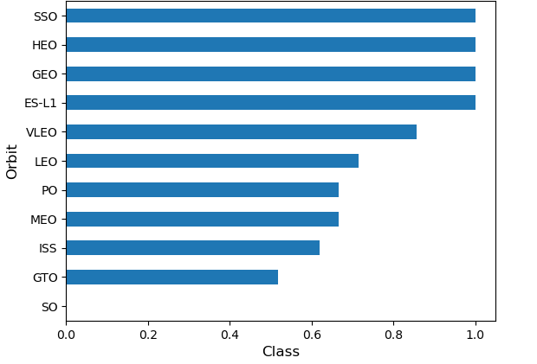
Success Rate vs. Orbit Type
SSO, HEO, GEO and ES-L1 orbits had the highest success rate.

Slide 21
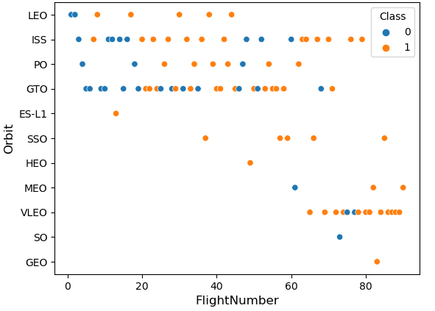
Flight Number vs. Orbit Type
In the LEO orbit the Success appears related to the number of flights; on the other hand, there seems to be no relationship between flight number when in GTO orbit.

Slide 22
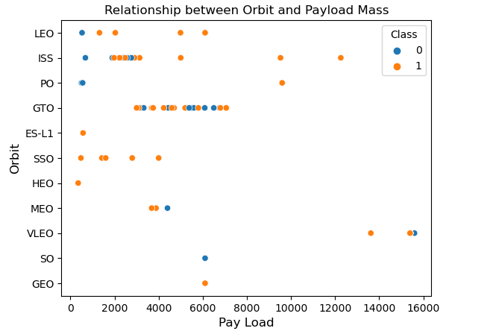
Payload vs. Orbit Type
With heavy payloads the successful landing rate are more for Polar, LEO and ISS. However for GTO we cannot distinguish this well as both successful landing rate and unsuccessful mission are both there here.

Slide 23
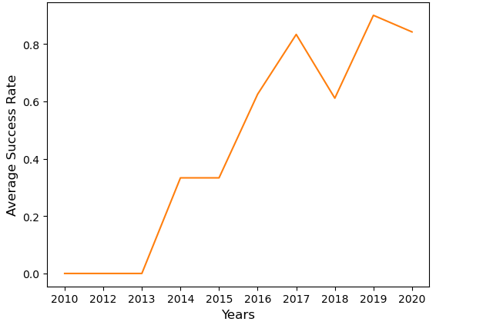
Launch Success Yearly Trend
The success rate since 2013 kept increasing till 2020

Slide 24
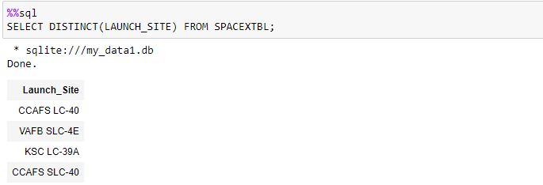
All Launch Site Names
Query Explanation: The distinct keyword in the query statement was used to ensure that only unique launch site names were retrieved.

Slide 25
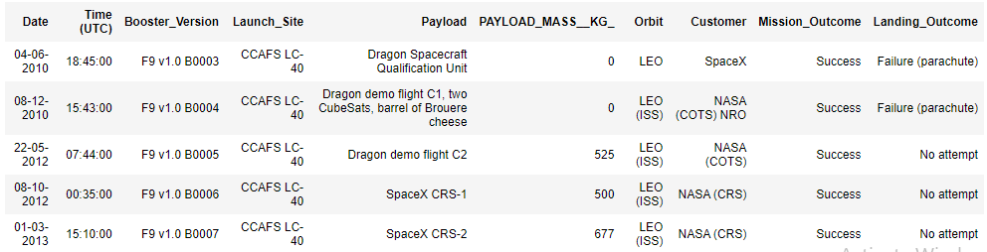
Launch Site Names Begin with 'CCA'
Query Explanation: We use the like, CCA and the limit keywords to ensure that only site names that begins with CCA and only first five records were retrieved.

Slide 26
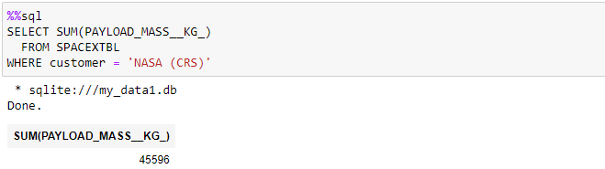
Total Payload Mass
Query Explanation: The sum function was used to aggregate the total payload mass while the where function was applied to filter the dataframe only for where customer is NASA (CRS)

Slide 27
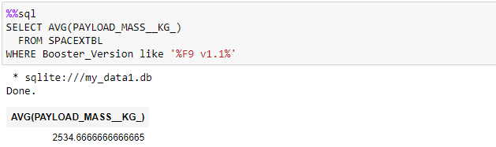
Average Payload Mass by F9 v1.1
Query Explanation: The AVG function was used to find the average payload mass while the where function was applied to filter the dataframe only where booster version contains F9 v1.1

Slide 28
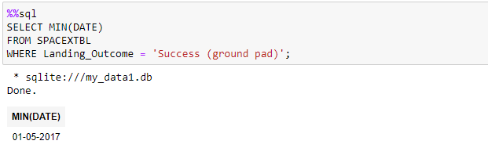
First Successful Ground Landing Date
Query Explanation: The dates of the first successful landing outcome on ground pad was calculated by simply using the min function and then filtering the data frame using the where clause to obtain the data where landing outcome is success ground pad

Slide 29
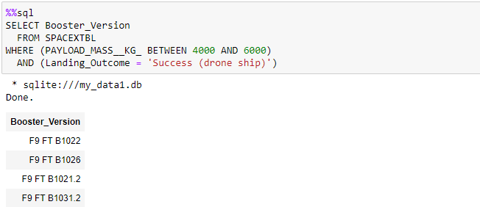
Successful Drone Ship Landing with Payload between 4000 and 6000
Query Explanation: The WHERE, BETWEEN & AND keywords were used in the query to list the names of boosters which have successfully landed on drone ship and had payload mass greater than 4000 but less than 6000

Slide 30
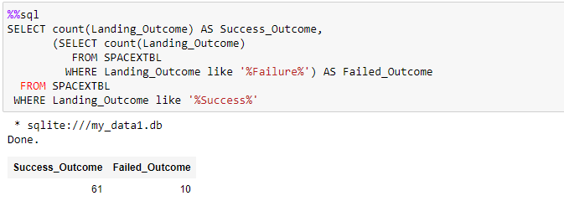
Total Number of Successful and Failure Mission Outcomes
Query Explanation: Sub query was used together with the count function to calculate the total number of successful and failure mission outcomes

Slide 31
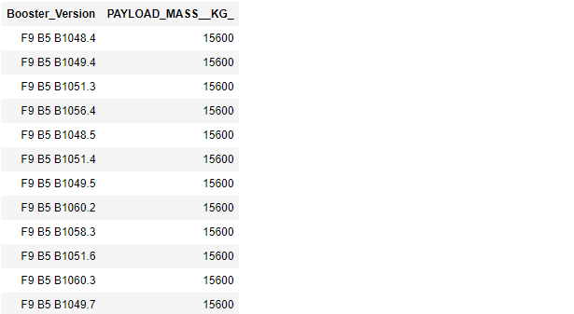
Boosters Carried Maximum Payload
Query Explanation: A subquery was used to find the maximum payload mass while the main query was used to retrieve is the names of the booster which have carried this maximum payload mass

Slide 32
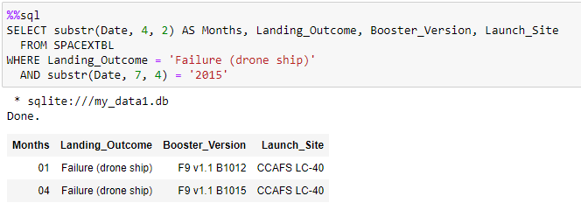
2015 Launch Records
Query Explanation: The substr function was used to retrieve the date in 2015 and the WHERE clause was used to filter the data frame for failed landing outcomes in drone ship.

Slide 33
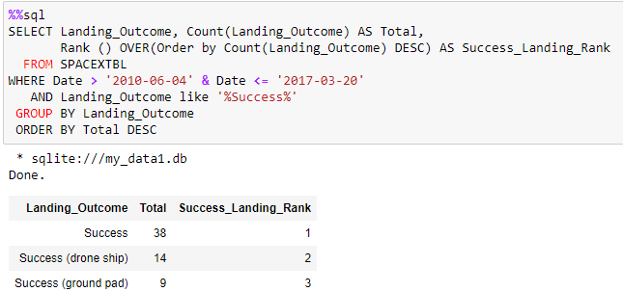
Rank Landing Outcomes Between 2010-06-04 and 2017-03-20
Query Explanation: The count function was first used to count the landing outcome between the date 2010-06-04 and 2017-03-20, in descending order and then the rank function was applied

Slide 34

Section 3

Slide 35
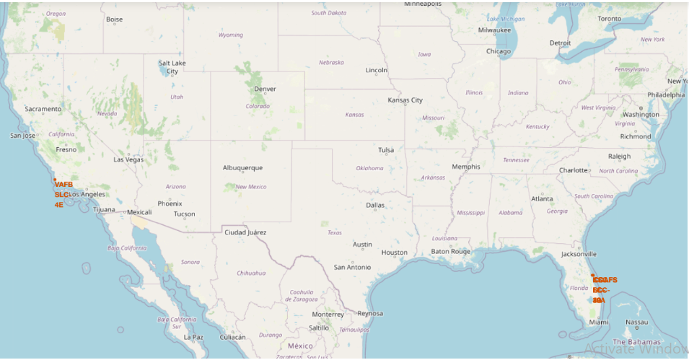
Map showing Launch site Locations
The locations of the launch sites from the map shows that the launch sites are in very close proximities to the coast lines and distance away from the equator

Slide 36
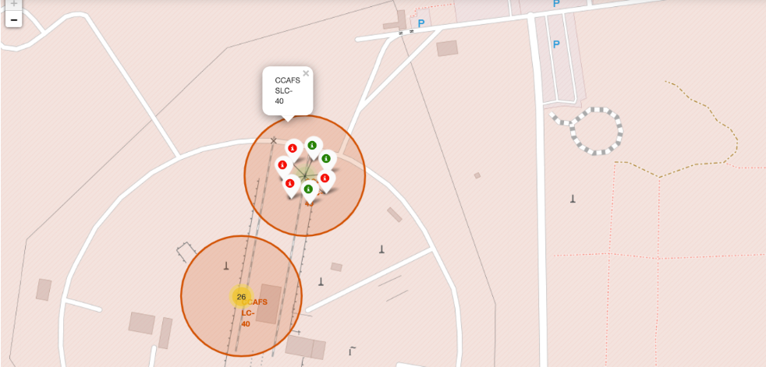
Success Rate of Launches for each site on the Map
Green color stands for successful launch outcome while red color stands for a failed launch outcome

Slide 37
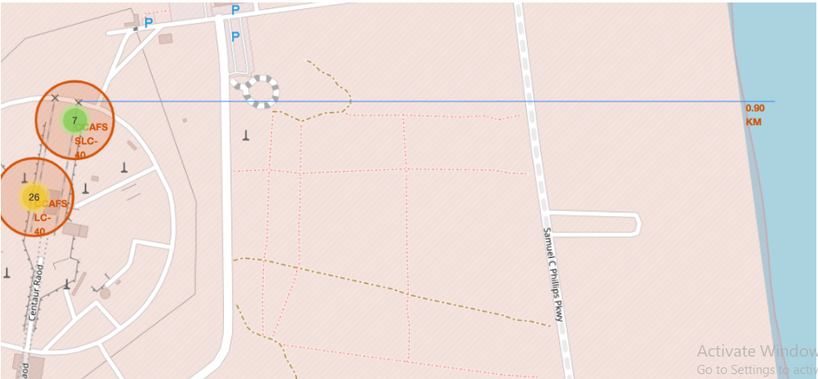
Map showing launch sites distance to proximities
The launch sites appear to be close be in close proximities with railway, highway, coastline, with distance calculated as 0.9km

Slide 38

Section 4

Slide 39
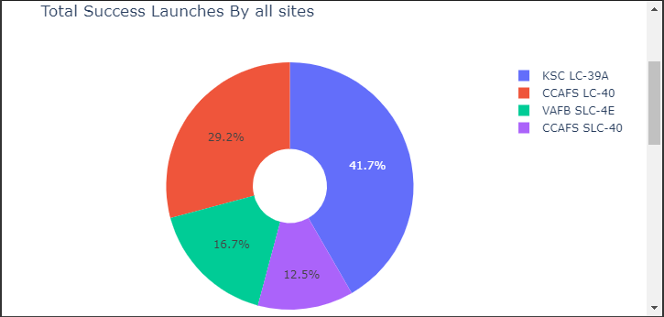
Total Success launches by all sites
KSC LC-39A site has the largest successful launches as well the highest launch success rate.

Slide 40
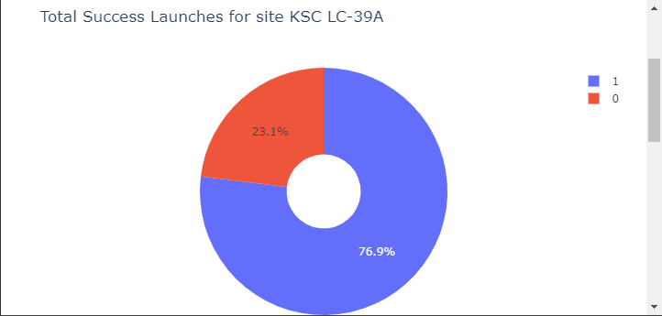
Total Success launches for site KSC LC-39A
As shown from the chart, site KSC LC-39A recorded 76.9% success rate

Slide 41
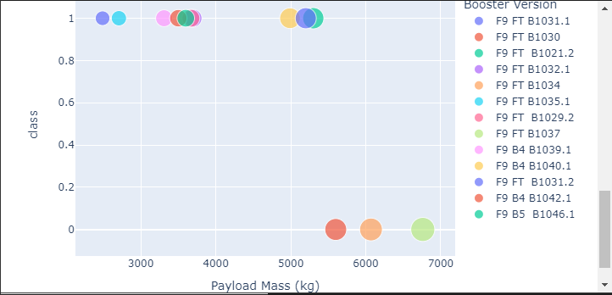
Class vs. Payload Mass (kg)
The payload range between 2000 to 6000kg seems to have the largest success rate

Slide 42

Section 5

Slide 43
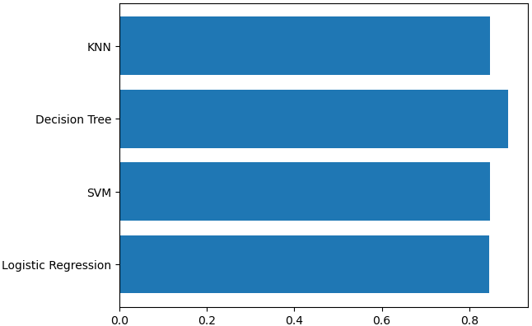
Classification Accuracy
Visualizing the built model accuracy for all built classification models in a bar chart shows that decision tree has the highest classification accuracy with an accuracy of 88.9%

Slide 44
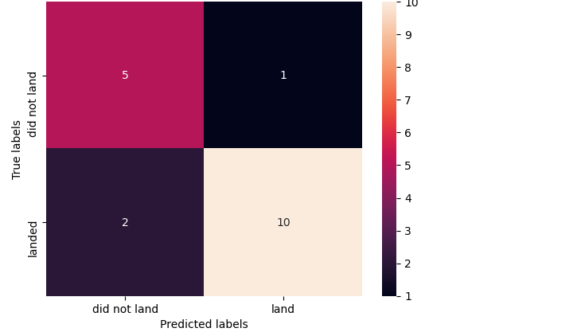
Confusion Matrix
From the confusion matrix shown above the model correctly predicted 5 outcome of 6 not landing and correctly predicted 10 outcome landing from a possible 12.

Slide 45
Conclusions
The Decision tree classifier has been proved to be the best model to be used for the prediction (classification) as it has the highest classification accuracy
The decision tree classifier has an accuracy of 88.9%. The model correctly predicted 5 outcome of 6 not landing and correctly predicted 10 outcome landing from a possible 12.
The launch sites are located near highways, coastlines and railways for ease of transportations.
The trend analysis shows that there has been record of increasing success rate since 2013 till 2020
The price of each launch can now be determined .

Slide 46
Appendix
GitHub link of the project: https://github.com/Dedonrukks/Data-Science-Capstone-Project

Slide 47


